Slide 1


School of Engineering Technology and Applied Science
The Machine Learning Process
using a decision tree model
Part 05
Reza Dibaj
Notes:
In this section, we are going to do something special, and that is writing our own classifier from the scratch.

Slide 2
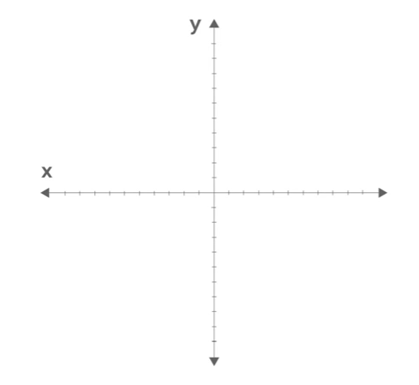
Writing Our First Classifier
Nearest Neighbor
Notes:
If you are new to Machine Learning, this is a big milestone. Because if you can follow along and do this on your own, it means that you understand an important piece of the puzzle.
The classifier that we are going to write today is a scrappy version of k-Nearest Neighbors. That is one of the simplest classifiers around.

Slide 3
Contents
A Quick Review
Step 1: Comment out imports
Step 2: Implement a class
Step 3: Understand interface
Step 4: Get pipeline working
Step 5: Intro to k-NN
Step 6: Measure distance
Step 7: Implement nearest neighbor algorithm
Step 8: Run pipeline
Conclusion

Slide 4
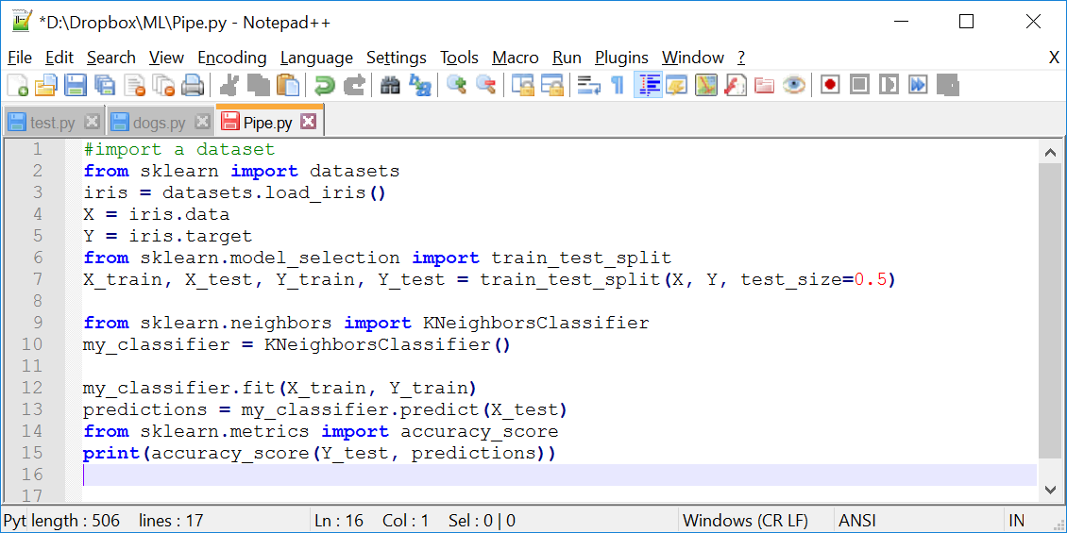
A Quick Review
Recall the program that we have already wrote:
import dataset
split data into train and test
train the classifier
test the accuracy
4
Notes:
We imported a dataset and split it into train and test.
We used train to train a classifier, and test to see how accurate it was.
Writing a classifier is the part we are going to focus on today.
Previously we imported the classifier from a library using these two lines.

Slide 5
Step 1
Comment out imports
Notes:
Here we comment them out and write our own.
The rest of the pipeline will stay exactly the same.
I will pop in and pop out of the screencast to explain things as we go along.

Slide 6
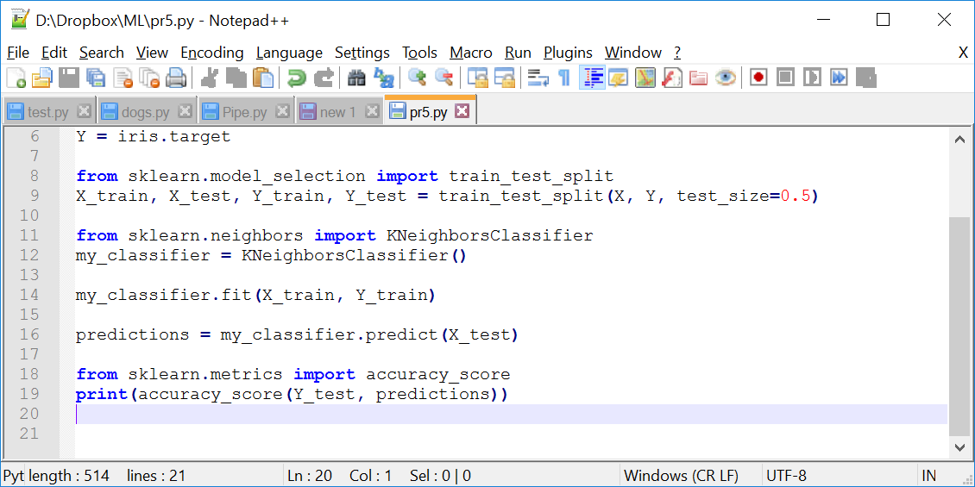
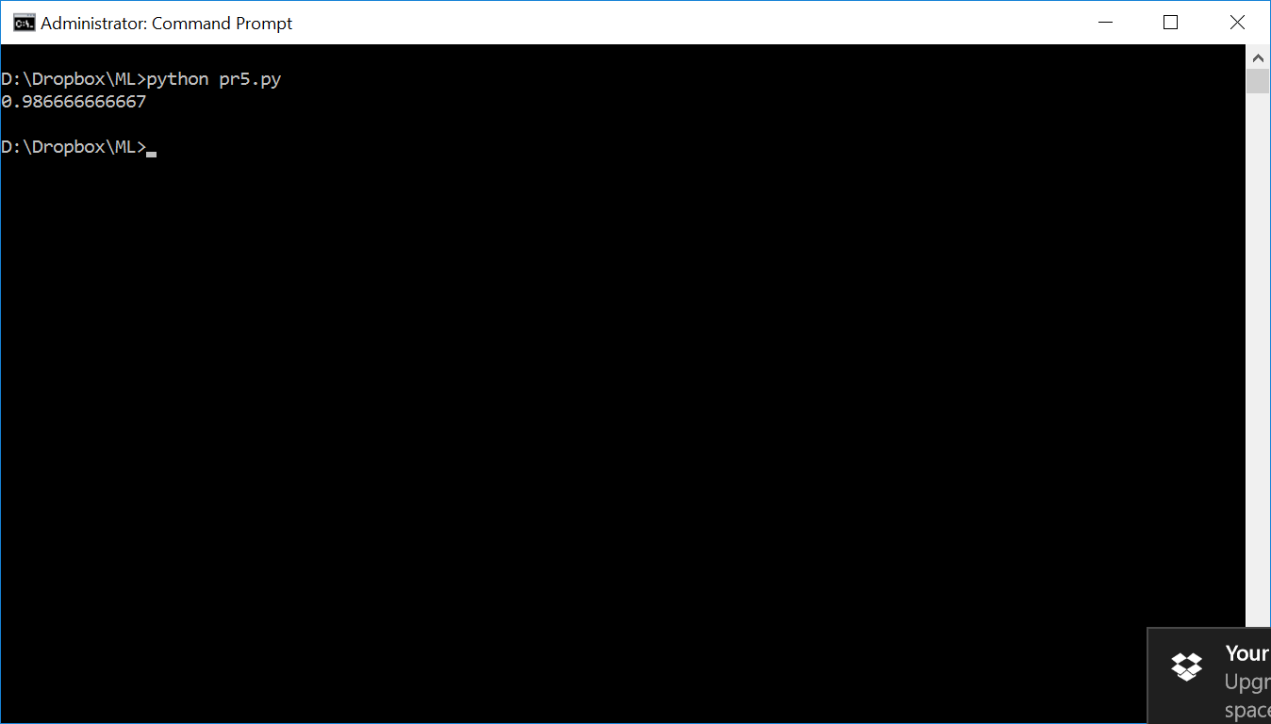
Step 1: Comment out imports
Let’s run our pipeline to remind the accuracy:
6
Notes:
The accuracy of the current classifier is over 90% and that is the goal for the classifier we will write ourselves.
The code is as follows:
#import a dataset
from sklearn import datasets
iris = datasets.load_iris()
X = iris.data
Y = iris.target
from sklearn.model_selection import train_test_split
X_train, X_test, Y_train, Y_test = train_test_split(X, Y, test_size=0.5)
from sklearn.neighbors import KNeighborsClassifier
my_classifier = KNeighborsClassifier()
my_classifier.fit(X_train, Y_train)
predictions = my_classifier.predict(X_test)
from sklearn.metrics import accuracy_score
print(accuracy_score(Y_test, predictions))

Slide 7
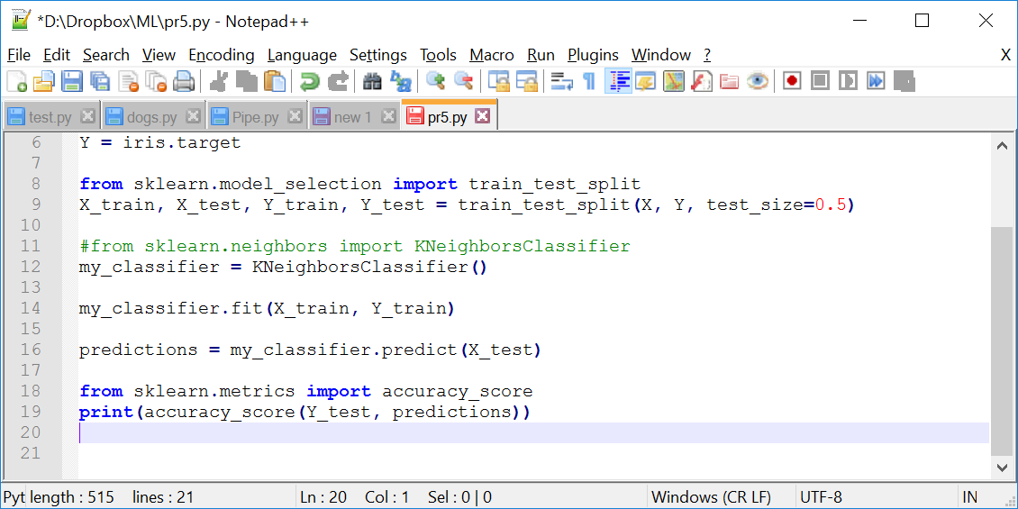
Step 1: Comment out imports
Let’s comment out the import:
7
Notes:
Let’s comment out that import. Right of the bat, this breaks our code.
The code is as follows:
#import a dataset
from sklearn import datasets
iris = datasets.load_iris()
X = iris.data
Y = iris.target
from sklearn.model_selection import train_test_split
X_train, X_test, Y_train, Y_test = train_test_split(X, Y, test_size=0.5)
#from sklearn.neighbors import KNeighborsClassifier
my_classifier = KNeighborsClassifier()
my_classifier.fit(X_train, Y_train)
predictions = my_classifier.predict(X_test)
from sklearn.metrics import accuracy_score
print(accuracy_score(Y_test, predictions))

Slide 8
Step 2
Implement a class
Notes:
So the first thing we need to do is fix our pipeline.
And to do that, we will implement a class for our classifier.

Slide 9
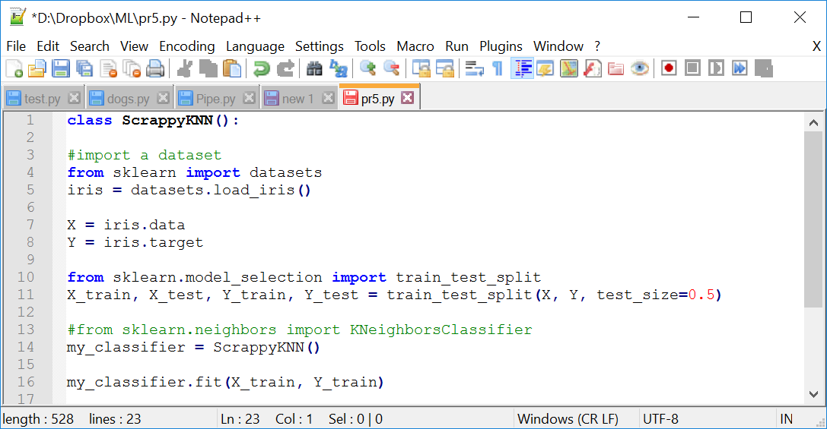
Step 2: Implement a class
Writing a bare-bone KNN class:
1
2
9
Notes:
We call that classifier, ScrappyKNN(), just enough to get it working.
Next we will change our pipeline to use it.

Slide 10
Step 3
Understand interface
Notes:
Now let’s see what methods we need to implement.

Slide 11
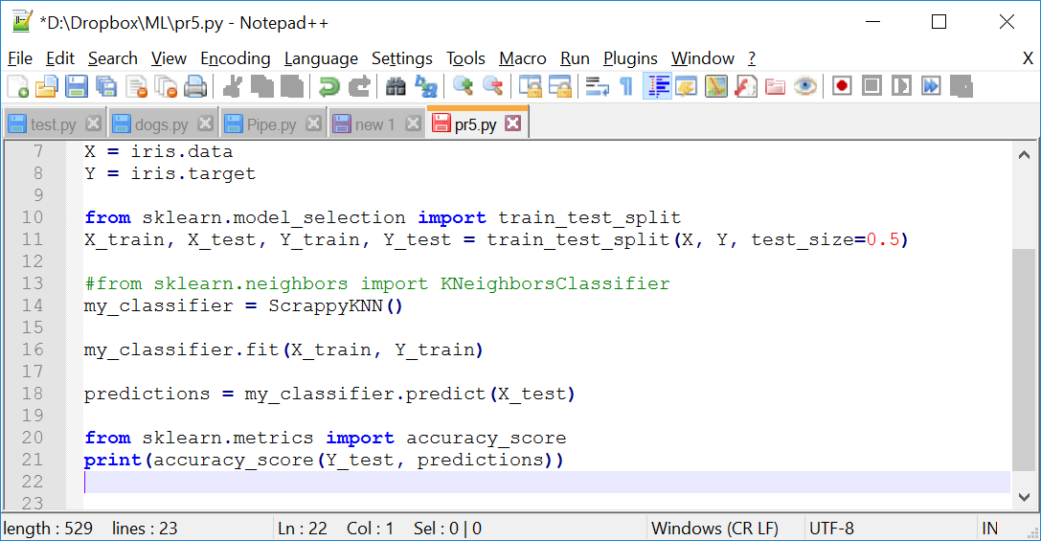
Step 3: Understand interface
Looking at the classifier interface:
11
Notes:
Looking at the classifier interface, we see there are two we care about:
Fit: which does the training
Predict: does the prediction

Slide 12
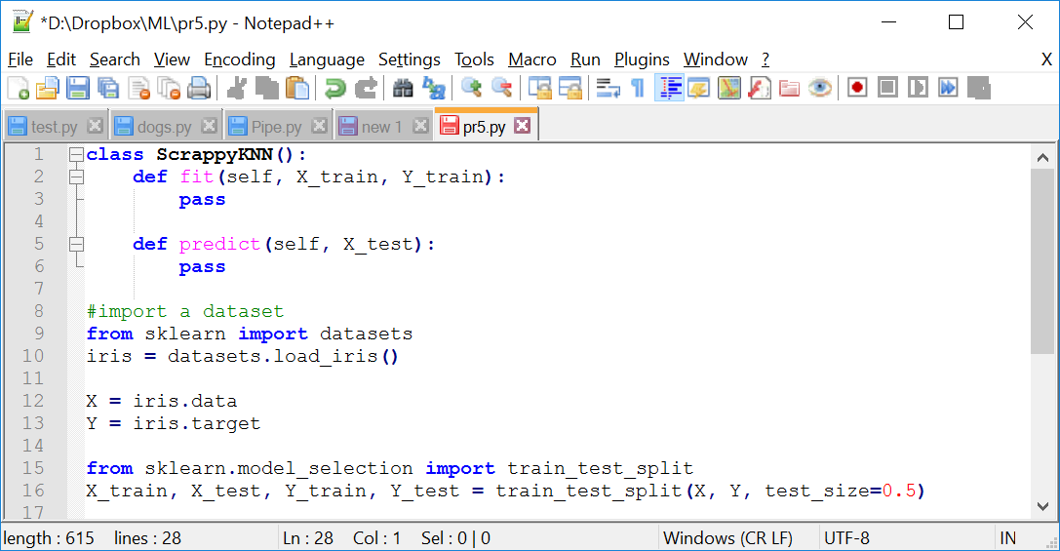
Step 3: Understand interface
Creating fit and predictions methods:
12
Notes:
First, we will declare the fit method. This takes the features and labels for the training set as input, so we will add parameters for those.
Then, let’s move on to our predict method.
As input, this receives the features for our testing data, and as output, it returns predictions for the labels.
The code is as follows:
class ScrappyKNN():
def fit(self, X_train, Y_train):
pass
def predict(self, X_test):
pass
#import a dataset
from sklearn import datasets
iris = datasets.load_iris()
X = iris.data
Y = iris.target
from sklearn.model_selection import train_test_split
X_train, X_test, Y_train, Y_test = train_test_split(X, Y, test_size=0.5)
#from sklearn.neighbors import KNeighborsClassifier
my_classifier = ScrappyKNN()
my_classifier.fit(X_train, Y_train)
predictions = my_classifier.predict(X_test)
from sklearn.metrics import accuracy_score
print(accuracy_score(Y_test, predictions))

Slide 13
Step 4
Get pipeline working
Notes:
Our first goal is to get the pipeline working, and to understand what these methods do.
So before we write our real classifier, we will start with something simpler, which is a random classifier.
By random, we will just guess the label.

Slide 14
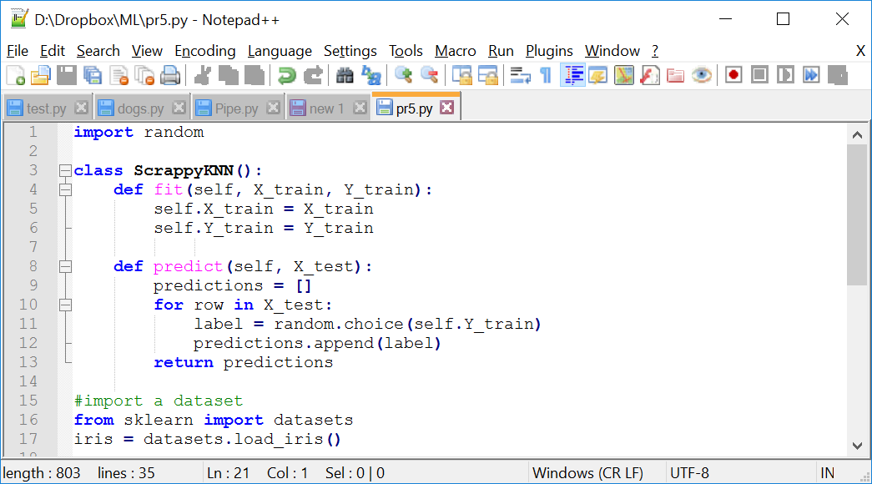
Step 4: Get pipeline working
Adding some code to the fit and predict methods:
14
Notes:
In fit, we will store the training data in this class.
Inside the predict method, we need to return a list of predictions. The reason for that is the parameter X_test is a 2D array, or list of lists.
Each row contains the features for one testing example.
To make a prediction for each row, we will randomly pick a label from the training data and append that to our predictions.
At this point, our pipeline is working again.
The code is as follows:
import random
class ScrappyKNN():
def fit(self, X_train, Y_train):
self.X_train = X_train
self.Y_train = Y_train
def predict(self, X_test):
predictions = []
for row in X_test:
label = random.choice(self.Y_train)
predictions.append(label)
return predictions
#import a dataset
from sklearn import datasets
iris = datasets.load_iris()
X = iris.data
Y = iris.target
from sklearn.model_selection import train_test_split
X_train, X_test, Y_train, Y_test = train_test_split(X, Y, test_size=0.5)
#from sklearn.neighbors import KNeighborsClassifier
my_classifier = ScrappyKNN()
my_classifier.fit(X_train, Y_train)
predictions = my_classifier.predict(X_test)
from sklearn.metrics import accuracy_score
print(accuracy_score(Y_test, predictions))

Slide 15
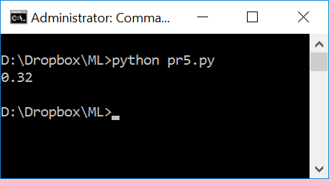
Step 4: Get pipeline working
The result of using random prediction methods:
15
Notes:
Recall there are three different types of flowers in the Iris Dataset, so the accuracy should be around 33%.

Slide 16
Step 5
Intro to k-NN
Notes:
Now we know the interface for a classifier, but when we started this exercise, our accuracy was above 90%. So let’s see if we can do better.
To do that, we will implement our classifier, which is based on k-Nearest Neighbors.

Slide 17
Step 5: Intro to k-NN
Intuition for how the algorithm works:
?
Notes:
Imagine the dots we see on the screen are the training data we memorized in the fit method, say for a toy dataset.
Now imagine we are asked to make a prediction for the testing point that is drawn in gray.

Slide 18
Step 5: Intro to k-NN
Intuition for how the algorithm works:
?
Notes:
How can we do that?
In nearest neighbor classifier it works exactly like it sounds.
We will find the training point that is closest to the testing point. This point is the nearest neighbors.
Then we will predict that the testing point has the same label.
For example, we will guess that this testing dot is green, because that is the color of its nearest neighbor.

Slide 19
Step 5: Intro to k-NN
Intuition for how the algorithm works:
?
Notes:
As another example, if we had a testing dot over here, we would guess it is red.

Slide 20
Step 5: Intro to k-NN
Intuition for how the algorithm works:
?
Notes:
Now what about this one right in the middle?
Imagine that this dot is equidistance to the nearest green dot and the nearest red one. There is a tie, so how could we classify it?
One way is is we can randomly break the tie. But there is another way, and that is where k means comes in.

Slide 21
Step 5: Intro to k-NN
K = # of neighbors to consider
?
Notes:
K is the number of neighbors we consider when making our prediction.
If k was 1, we would just look at the closest training point.
But if k was 3, we would look at the three closest.
In this case, two of those are red and one is green. To predict we could vote and predict the majority class. Now there is more details in this algorithm, but that is enough to get started.

Slide 22
Step 6
Measure distance
Notes:
To code this up, we will need a way to find the nearest neighbor.

Slide 23
Step 6: Measure distance
K = # of neighbors to consider
?
Notes:
And to do that, we will measure the straight line distance between two points, just like you do with a ruler.

Slide 24
Step 6: Measure distance
Euclidian Distance
Notes:
There is a formula for that called the Euclidian Distance, and here is what the formula looks like.

Slide 25

Step 6: Measure distance
Euclidian Distance
distance
Y₂ – Y₁
X₂ – X₁
$$d\left(a,b\right)= \sqrt{{\left(X_{2}+X_{1}\right)}^{2}+{\left(Y_{2}+Y_{1}\right)}^{2}}$$
Notes:
There is a formula for that called the Euclidian Distance, and here is what the formula looks like.
It measures the distance between two points, and it works like a Pythagorean theorem. (A squared plus B squared equals C squared)
You can think of one edge as A, or difference between the first two features. Likewise, you can think of the other esge as B, or the difference between the second pair of features.
And the distance we compute is the length of the hypotenuse.

Slide 26

Step 6: Measure distance
Euclidian Distance
$$d\left(a,b\right)= \sqrt{{\left(X_{2}+X_{1}\right)}^{2}+{\left(Y_{2}+Y_{1}\right)}^{2}+{\left.…+(N_{2}+N_{1}\right)}^{2}}$$
$$d\left(a,b\right)= \sqrt{{\left(X_{2}+X_{1}\right)}^{2}+{\left(Y_{2}+Y_{1}\right)}^{2}}$$
Notes:
Right now, we are computing distance in two-dimensional space, because we have just two features in our toy dataset.
But what if we have three features or three dimensions? Then, we would be in a cube. We can still visualize how to measure distance in the space with a ruler. But what if we had four features, or four dimensions, like we do in Iris. In that condition we are in a hypercube that cannot be visualized easily.
The good news is the Euclidian Distance works the same way regardless of the number of dimensions.
With more features, we can just add more terms to the question.

Slide 27
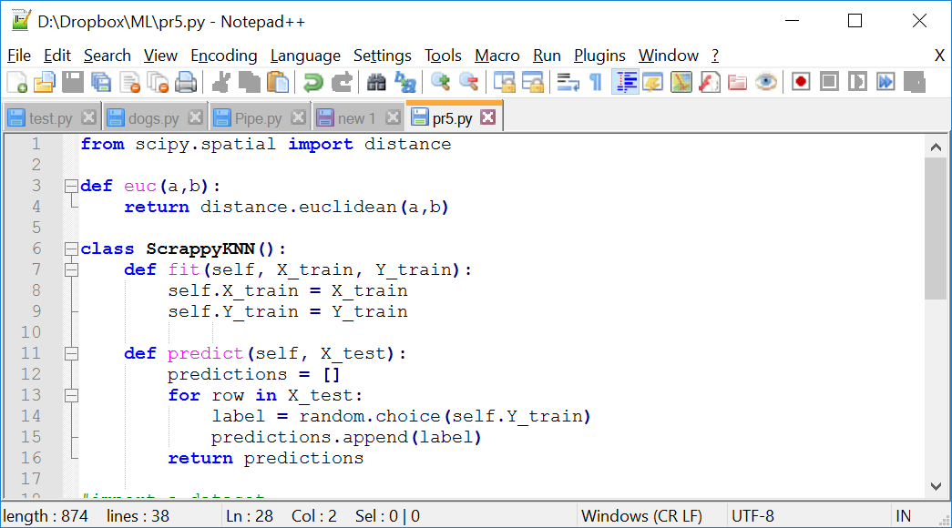
Step 6: Measure distance
Let’s code up Euclidian Distance
Notes:
There are plenty of ways to do that, but we will use a library called scipy that is already installed by Anaconda.
Here, (a) and (b) are lists of numeric features.
Imagine (a) is a point from our training data, and (b) is a point from our testing data. This function returns the distance between them.
The code is as follows:
from scipy.spatial import distance
def euc(a,b):
return distance.euclidean(a,b)
class ScrappyKNN():
def fit(self, X_train, Y_train):
self.X_train = X_train
self.Y_train = Y_train
def predict(self, X_test):
predictions = []
for row in X_test:
label = random.choice(self.Y_train)
predictions.append(label)
return predictions
#import a dataset
from sklearn import datasets
iris = datasets.load_iris()
X = iris.data
Y = iris.target
from sklearn.model_selection import train_test_split
X_train, X_test, Y_train, Y_test = train_test_split(X, Y, test_size=0.5)
#from sklearn.neighbors import KNeighborsClassifier
my_classifier = ScrappyKNN()
my_classifier.fit(X_train, Y_train)
predictions = my_classifier.predict(X_test)
from sklearn.metrics import accuracy_score
print(accuracy_score(Y_test, predictions))

Slide 28
Step 7
Implement nearest neighbor algorithm
Notes:
Let’s take a look at the algorithm for a classifier.
To make a prediction for a test point, we will calculate the distance to all the training points. Then we will predict the testing point has the same label as the closest one.

Slide 29
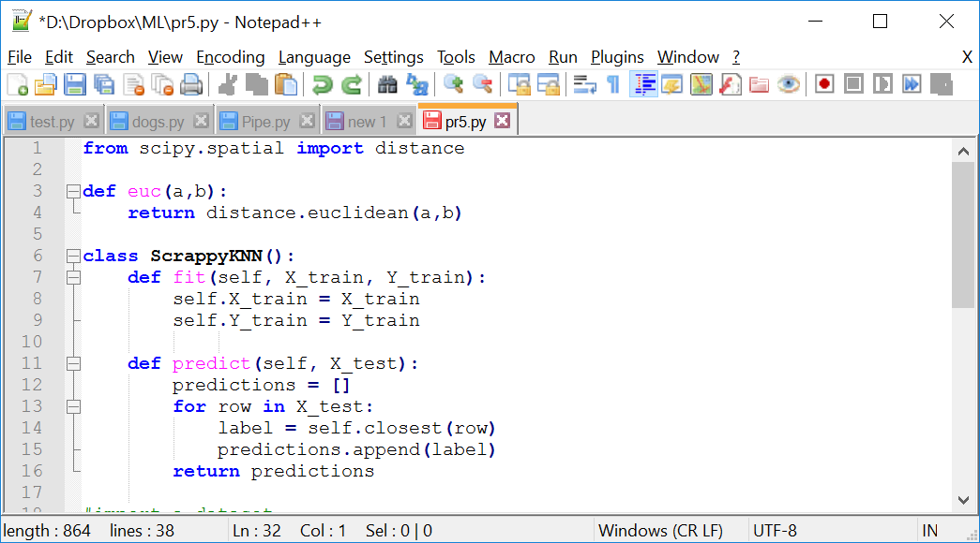
Step 7: Implement nearest neighbor algorithm
Let’s code up nearest neighbor algorithm
Notes:
We should delete the random prediction we made, and replace it with a method that finds the closest training point to the test point.
For this presentation we will hard-code k to 1, so we will write a nearest neighbor classifier. The k variable will not appear in our code, since we will always just find the closest point.
The code is as follows:
from scipy.spatial import distance
def euc(a,b):
return distance.euclidean(a,b)
class ScrappyKNN():
def fit(self, X_train, Y_train):
self.X_train = X_train
self.Y_train = Y_train
def predict(self, X_test):
predictions = []
for row in X_test:
label = self.closest(row)
predictions.append(label)
return predictions
#import a dataset
from sklearn import datasets
iris = datasets.load_iris()
X = iris.data
Y = iris.target
from sklearn.model_selection import train_test_split
X_train, X_test, Y_train, Y_test = train_test_split(X, Y, test_size=0.5)
#from sklearn.neighbors import KNeighborsClassifier
my_classifier = ScrappyKNN()
my_classifier.fit(X_train, Y_train)
predictions = my_classifier.predict(X_test)
from sklearn.metrics import accuracy_score
print(accuracy_score(Y_test, predictions))

Slide 30
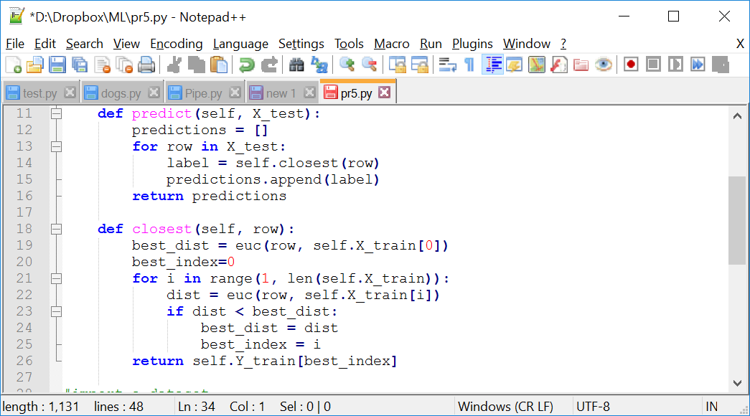
Step 7: Implement nearest neighbor algorithm
Let’s code up nearest neighbor algorithm
Notes:
Inside this method, we will loop over all the training points and keep track of the closest one so far.
Remember that we memorized the training data in our fit function, and X_train contains the features. To start, we will calculate the distance from the test point to the first training point.
We use best_dist variable to keep track of the shortest distance we have found so far.
Also we use best_index to keep track of the index of the closest training point as we need this later to retrieve its label.
Then we will iterate over all the other training points, and every time we find a closer one, we will update our variables.
Finally, we will use the index to return the label for the closest training example.
The code is as follows:
from scipy.spatial import distance
def euc(a,b):
return distance.euclidean(a,b)
class ScrappyKNN():
def fit(self, X_train, Y_train):
self.X_train = X_train
self.Y_train = Y_train
def predict(self, X_test):
predictions = []
for row in X_test:
label = self.closest(row)
predictions.append(label)
return predictions
def closest(self, row):
best_dist = euc(row, self.X_train[0])
best_index=0
for i in range(1, len(self.X_train)):
dist = euc(row, self.X_train[i])
if dist < best_dist:
best_dist = dist
best_index = i
return self.Y_train[best_index]
#import a dataset
from sklearn import datasets
iris = datasets.load_iris()
X = iris.data
Y = iris.target
from sklearn.model_selection import train_test_split
X_train, X_test, Y_train, Y_test = train_test_split(X, Y, test_size=0.5)
#from sklearn.neighbors import KNeighborsClassifier
my_classifier = ScrappyKNN()
my_classifier.fit(X_train, Y_train)
predictions = my_classifier.predict(X_test)
from sklearn.metrics import accuracy_score
print(accuracy_score(Y_test, predictions))

Slide 31
Step 8
Run pipeline
Notes:
At this point, we have a working nearest neighbor classifier.
Let’s run it and see what the accuracy is.

Slide 32
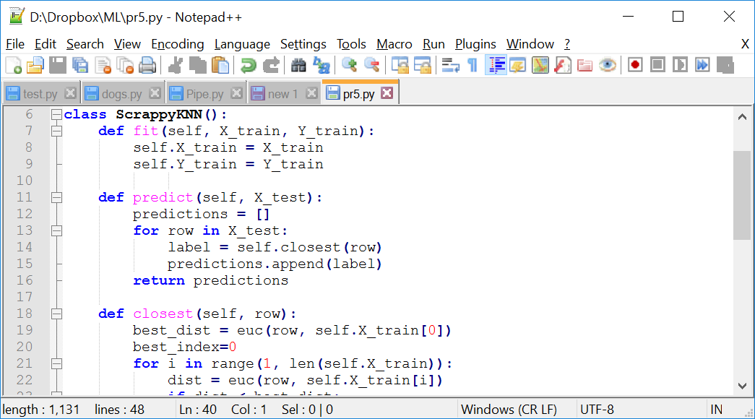
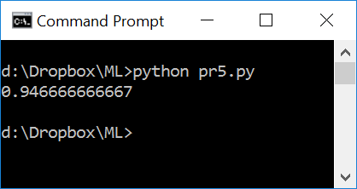
Step 8: Run pipeline
Let’s run up what we coded
Notes:
WE DID IT!
As you see, the accuracy is over 90%.
When you run this on your own, the accuracy might be a bit different, because of randomness in the train test.
Now if you can code this up and understand it, that is a big accomplishment, because it means that you can write a simple classifier from the scratch.
The code is as follows:
from scipy.spatial import distance
def euc(a,b):
return distance.euclidean(a,b)
class ScrappyKNN():
def fit(self, X_train, Y_train):
self.X_train = X_train
self.Y_train = Y_train
def predict(self, X_test):
predictions = []
for row in X_test:
label = self.closest(row)
predictions.append(label)
return predictions
def closest(self, row):
best_dist = euc(row, self.X_train[0])
best_index=0
for i in range(1, len(self.X_train)):
dist = euc(row, self.X_train[i])
if dist < best_dist:
best_dist = dist
best_index = i
return self.Y_train[best_index]
#import a dataset
from sklearn import datasets
iris = datasets.load_iris()
X = iris.data
Y = iris.target
from sklearn.model_selection import train_test_split
X_train, X_test, Y_train, Y_test = train_test_split(X, Y, test_size=0.5)
#from sklearn.neighbors import KNeighborsClassifier
my_classifier = ScrappyKNN()
my_classifier.fit(X_train, Y_train)
predictions = my_classifier.predict(X_test)
from sklearn.metrics import accuracy_score
print(accuracy_score(Y_test, predictions))

Slide 33
Conclusion
Pros
Relatively simple
Cons
Computationally intensive
Hard to represent relationships between features
Notes:
There are number of pros and cons to this algorithm, many of which you can find online.
The basic pro is that this algorithm is relatively easy to understand, and works reasonably well for some problems.
The basic cons are it is slow, because it has to iterate over every training point to make a prediction.
More importantly, some features are more informative than others. But there is not an easy way to represent that in k-Nearest Neighbors.

Slide 34
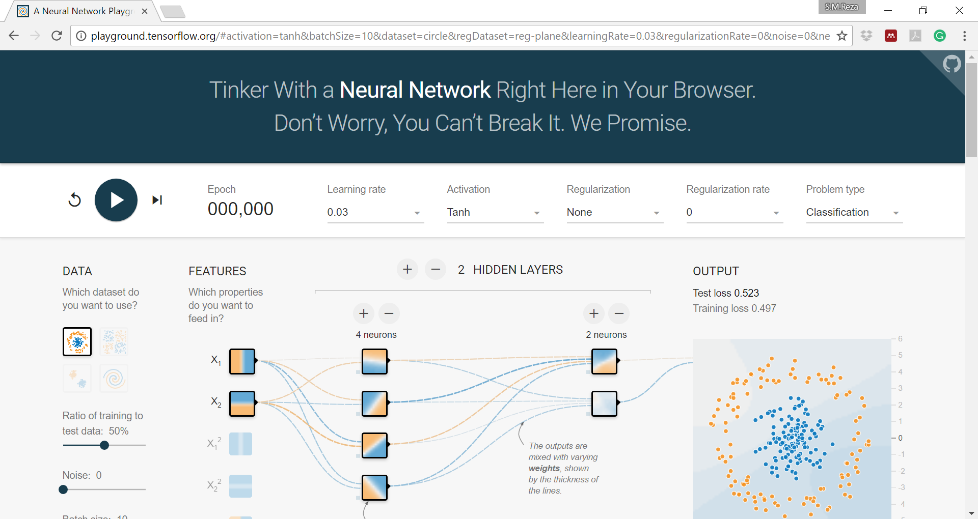
Conclusion
http://playground.tensorflow.org
Notes:
In a long run, we want a classifier that learns more complex relationships between features and the label we are trying to predict.
A decision tree is a good example of that, and a neural network, such as what we saw in TensorFlow playground is even better.

Slide 35
Thank you

